Slide 1
Some common benefits
Carer’s Allowance
Pension Credit
Universal Credit

Slide 2
*Carer’s Allowance – is a benefit for people who regularly care for disabled person who are in receipt of certain disability benefits.
A person can claim the Carer’s Allowance if they are 16 or over and caring for a disabled person in receipt of AA, PIP(DL) or DLA care at middle or higher rate.
How much? £67.60 pw (Apr 2021/ Apr 22 rate)

Slide 3
You can qualify for Carer’s Allowance if all the following apply:
• you regularly care for someone for at least 35 hours a week
• your earnings (after tax and NI deductions and certain expenses) are less than £128 a week
• you’re not in education for more than 21 hours a week
• the person you care for gets a qualifying disability benefit
• you meet the residency criteria

Slide 5
What does “caring” for someone means:
helping the disabled person in form of attention or supervision.
Can a disabled person in receipt of enhanced rate DL and Mobility of PIP, claim CA for looking after another disabled person?

Slide 6
Benefits, that can affect payment CA:
State Pension
Bereavement benefits /Widow’s benefits
Incapacity Benefit
Severe Disablement Allowance
New-style (cb) Jobseeker’s Allowance
New-Style (cb) Employment and Support Allowance
Maternity Allowance
No Carer’s Allowance payments, if you are in receipt of any of above benefits that add up to £67.60 pw or more
Should you still apply for CA, even if you know, because of the above-mentioned benefits you won’t get any CA payments?

Slide 7
If you cannot get CA benefit because of the Over-Lapping benefits, you may still have an underlying entitlement to the CA.
The advantage of having an underlying entitlement is that its passports you to the ‘carer’s premium/addition that increases your applicable amount of means-tested benefit such as PC, UC*, HB, ESA etc. by £37.70 pw.
That means you could This means you could get a higher rate of these benefits, or that you could qualify for them for the first time.

Slide 8
Will the benefits of cared person affected if you claim CA for looking after him/her?
If you claim the CA for a person, who is getting the ‘severe disability premium’ he or she will lose that SDP (worth £67.30 pw).

Slide 9
*State Pension Credit or more commonly referred to as Pension Credit - is a benefit for people over State Pension age. It provides as a top-up income for those with no income or low income.
Pension Credit has two elements Guarantee Pension Credit (GPC) and Savings Pension Credit (SPC).
Previously, only one of the couples needed to be pensionable age to claim PC. However, the government changed the rules from 15th May 2019, and from that date both partners need to be pensioners to qualify for Pension Credit

Slide 10
*Universal Credit – is now the main means-tested benefit. The government introduced this benefit for people who are on low income whether working or not it has replaced most of the legacy means-tested benefits. The rules and conditions for entitlement broadly based on mixture of DWP and HMRC acts and regulations.
it has replaced following benefits:
Housing Benefit
Income Support
income-based JSA
income-based ESA
Child Tax Credit
Working Tax Credit

Slide 11
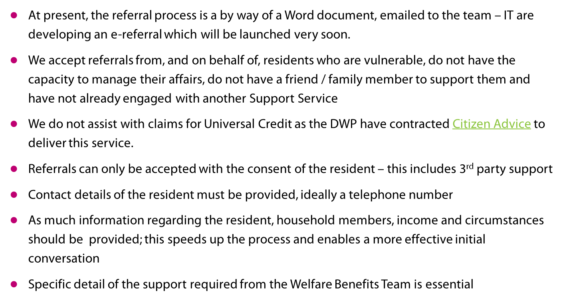
Making a referral

Slide 12
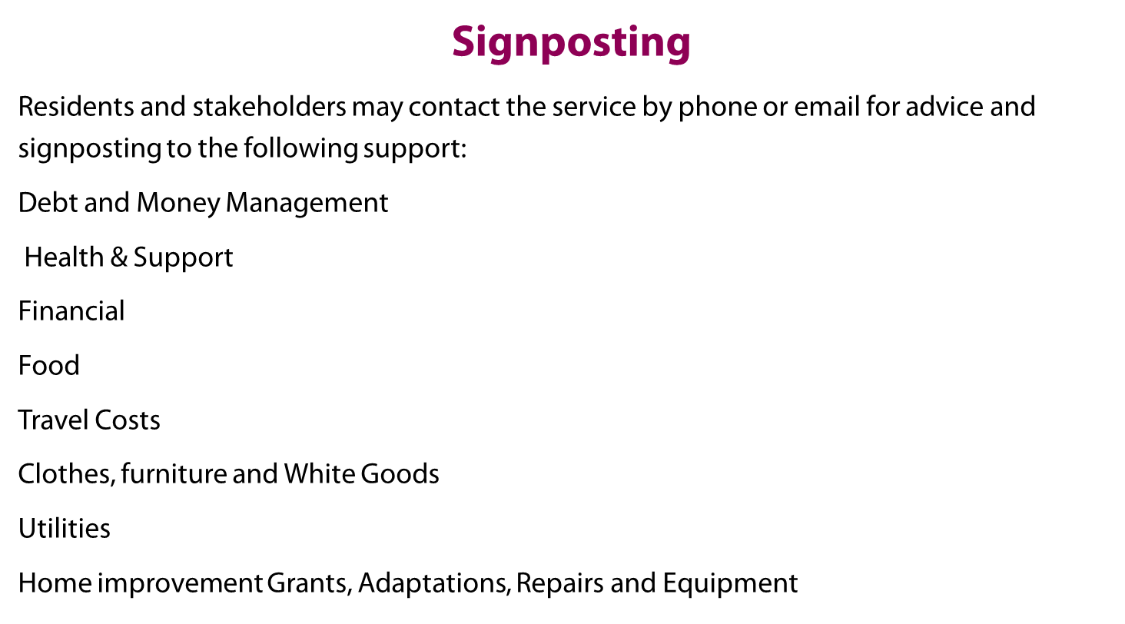

Slide 13
Contact Us
By email: Welfare.benefits@redbridge.gov.uk
Any referrals must be made using the following elink
https://www.redbridge.gov.uk/benefits/referral-to-welfare-benefits-team/
By telephone: 02087084180
Monday to Friday 9am - 12.30pm
By referral
Visit our webpage

