Slide 1
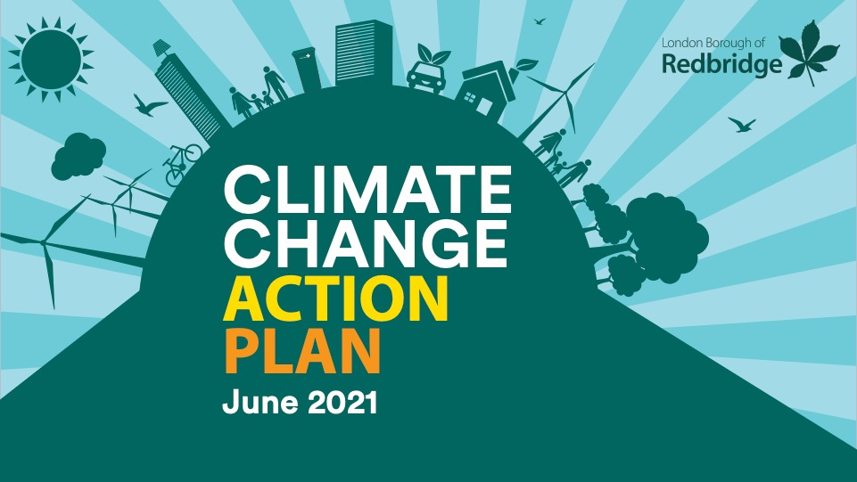

Slide 2
June 2019
Climate Emergency Declared
October 2019
Climate Change Corporate Panel Established
March 2020-July 2020
Engagement and Green Audit
November
2020
Corporate Panel Recommendations Published
June 2021
Action Plan presented to Cabinet
Notes:
Responded to the increased public concern and extensive scientific evidence on climate change by unanimously passing a climate emergency declaration at Full Council in June 2019.
The council committed to working towards making Redbridge Council carbon neutral by 2030, carbon zero by 2050, and, ensuring all council assets, existing and new, are as energy efficient as possible.
Established a Corporate Panel which used the findings of the Green Audit and various engagement activities to make recommendations to Cabinet.
Undertook a Green Audit which looked at the Corporate Estate and Vision estate – making recommendations for those areas in the council’s direct control. Identified buildings as the council’s main source of emissions.
Between March 2020 and July various engagement activities were undertaken. These consisted of a call for ideas, setting the council’s carbon budget and online workshops. The engagement illustrated that residents viewed the council as a community leader with a key role in enabling the local community to reduce its footprint. Top priorities included;
Enabling and encouraging active travel
Improving recycling offer in the borough
Facilitating residents to improve the energy efficiency of their homes
Facilitating the transition to EV vehicles
Purchasing Green Energy
Enhance both private and public green spaces
The Corporate Panel presented its recommendations for the themes Property and Energy, Cleaner Journeys, Waste, Biodiversity, Procurement and Investments, Enabling Others to Cabinet in November 2020.
The findings of the Green Audit, engagement and Corporate Panel recommendations have been used to pull together over 100 actions in the Climate Change Action Plan.

Slide 3
Breakdown of Emissions
Notes:
Total carbon emissions in 2017 for Redbridge as a borough was equivalent to one person flying to Singapore and back 1,142 times.
56% of the borough’s emissions originate from buildings (residential, commercial, institutional and industrial). Of these 75% originate from residential buildings whilst business establishments account for 25%
36% of the borough’s emissions arise from transport, of which 61% are from on-road transport (second highest emitter in the borough).
We need to work together to reduce these emissions and use our role as a community leader to support this.

Slide 4
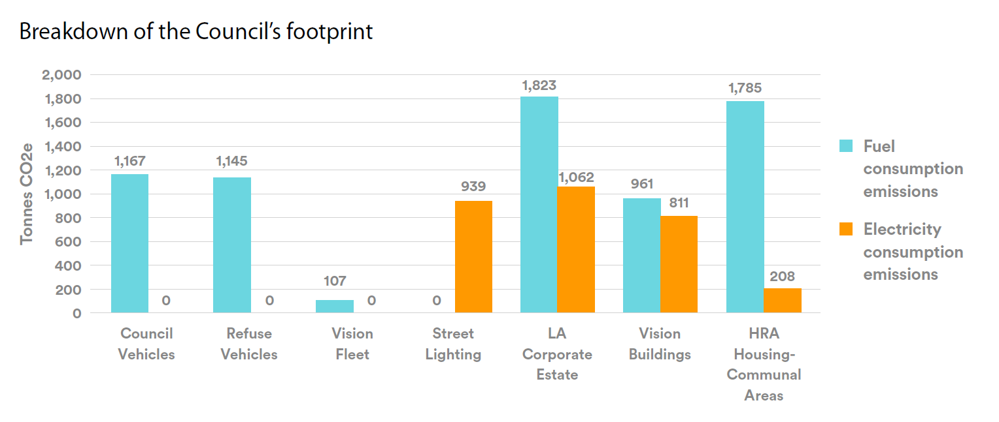
Council Emissions
These emissions will be annually monitored and reported to Place Scrutiny
Notes:
Council’s total direct emissions in 2019 totalled 10,008 tCO2e.
Scope 1: fuel from buildings and fleet (green bars)
Scope 2: electricity from buildings, street lighting and communal housing.
Commitment to annually report on these
Over next 3 years we expect to see
4% reduction in fuel used by our buildings and fleet
69% reduction in emissions arising from electricity consumed by street lighting and buildings
Further 31,256 tCO₂e emissions are attributable to our procured services (19,261 tCO₂e) and council tenants (11,995 tCO₂e). Scope 3 so these are produced by other organisations/people but illustrate the scale of emissions associated with our procurement activities. Will need to work with partners to address these and develop a monitoring framework.

Slide 5
Property and Energy
We have
We will
Develop a programme to reduce emissions from across Corporate and Vision buildings.
Work to reduce the emissions originating from both council and private housing.
Ensure developments are built to a high energy standard and consider the climate agenda.
Review the opportunities and scope for energy generation in the borough.
Launched a grant programme to support landlords improve the energy efficiency of their homes.
Commenced the installation of electricity smart metering across the Corporate Estate
Commenced a programme to retrofit properties within the council’s housing stock.
Rolled out LED street lighting across the borough
Installed solar electricity panels on a number of schools and buildings across the borough.
Notes:
Buildings are the main source of emissions for both the borough and council. We expect 66-80% of today’s buildings to still exist in 2030.
The carbon emissions associated with our buildings arise from the energy inefficiency of the building, the building fabrics and materials, and, the lack of consumption of green energy.
We also know that we will need to complement improving the energy efficiency of our buildings with the purchasing of low carbon and renewable energy sources.
These are some examples of the work we have started doing and will build on.
Some examples of how we will achieve this are
Switch to a green electricity tariff across the controlled elements of the building stock.
Create a costed programme to replace gas boilers and improve insulation where feasible.
Work with private landlords to purchase green energy and consider potential for small scale community based renewable energy generation.
Through retrofit projects, bring a further 5% of housing stock up to EPC C each year.
Work with private landlords and housing associations to ensure all properties in the private rented sector are at least EPC D by April 2022.
Require developers to build net zero homes in line with the New London Plan, pushing for the highest standards and renewables before offsets are considered. This will be aligned with the energy hierarchy as set out in the New London Plan.
Assess opportunities for solar power on schools and across the Vision estate.

Slide 6
Cleaner Journeys
We have
We will
Started a fleet conversion programme to ensure Ultra Low Emission Zone (ULEZ) compliance.
Introduced a workplace travel programme to reduce business travel including providing a pool of electric cars and bikes for staff.
Rolled out Electric Vehicle Charging Point infrastructure across the borough.
Started developing two mobility hubs.
Trialled and rolled out the first school
Require travel plans in major developments streets in the borough.
Continue to reduce the emissions associated with the council’s fleet.
Continue to reduce associated emissions from road-based travel.
Actively work towards the Mayor’s Transport Target of achieving 80% of all journeys in London to be made active, efficient and sustainable modes.
Develop infrastructure to enable active travel and use of electric vehicles.
Notes:
To reduce emissions from transport we will encourage our communities to make a modal shift through ensuring land-use planning considers public transport accessibility, zero or minimum car parking provisions, traffic management and parking controls, and/or investment in walking, cycling and public transport infrastructure. However, where vehicle use is unavoidable, we will need to support the accessibility to electric vehicles and charging points or car sharing schemes.
We have already started this work having
purchased our first electric vehicles for the fleet.
Achieved 48% of average journeys in Redbridge being made by walking, cycling and public transport.
We will need to build on these great examples to continue reduce road based travel emissions and support the Mayor’s Transport Strategy target of achieving 80% of all journeys to be made by active, efficient and sustainable modes – public transport, walking and cycling – by 2041. (This is across London).
Some examples of what we will do include;
Explore hydrogen technology as an alternative to electric to run the Large Goods Vehicle fleet.
Subject to feasibility and consultation install at least 100 Electric Vehicle charging points a year.
Subject to funding introduce 5km of new cycle lanes per year for the next 5 years.

Slide 7
Waste and Procurement
We have
We will
Decrease waste and increase recycling amongst residents.
Reduce food waste and encourage food composting.
Decrease waste and improve recycling across the Corporate Estate
Ensure the procurement of goods and services reflect the carbon neutral agenda.
Ensure investments consider the green agenda.
Developed a Waste Reduction Strategy.
Rolled out a successful wheelie bin trial.
Began investing in a low carbon fund.
Run a number of workshops and campaigns on minimising waste
Notes:
Waste
Our current waste agreement means we divert 99.98% of waste away from landfill however, in 2017/2018 we disposed of 70,172 tonnes of residual (black bag) waste, enough to fill 2,511 London Routemaster double decker buses.
Food waste makes up approx. 50% of contents currently placed in black bags as rubbish.
We need to change the way we think about waste and how we dispose of it. We need to reduce waste and increase the amount we re-use and recycle. The disposal of residual black bag waste should only be considered as a last resort. We have already started this journey having (see images)
Some examples of what we will do include to achieve these ambitions include
Lobby ELWA to increase recycling offer in the borough.
Reduce Redbridge's residual waste arising per household to less than 65kg per household per year.
Have worked successfully with ELWA to enable the introduction of separate food waste collections to all street level properties in Redbridge.
Review current recycling offer in schools and commercial waste to further levels of recycling.
Procurement and Investments
Relates to how we use our money and the goods or services we buy. As emissions caused by other organisations these are outside the council’s direct emissions however, we will change the way we work to incentivise change and enable innovation in the borough and amongst our suppliers.
We have already started reducing these carbon emissions, as part of our procurement processes we consider social value including environmental concerns at 10% of the contract evaluation value and within our investment processes, we have begun investing in a low carbon fund whilst meeting our obligations to our pension fund members.
Some examples of what we will do include to achieve these ambitions include
Develop a pilot requiring strategic suppliers to provide climate impact assessments.
Evaluate opportunities within existing contracts to track supply chain emissions.
Undertake a review of pensions and investments to develop a baseline of those invested in fossil fuels, and, present findings to Local Pension Board for consideration

Slide 8
Nature and the Environment
We have
We will
Partnered with Trees for Cities to deliver an extensive tree planting programme across schools and parks.
Planted over 1,100 trees on the highway between May 2020 and April 2021.
Developed grow zones in 20 locations across the borough totalling 20,000m².
Support the prioritization of a green infrastructure approach that both mitigates and adapts to climate change.
Develop a Green Urban Landscape Policy
Support the findings of the Nature and Environment Task and Finish Group
Notes:
Nature and Environment
We must not forget the role of the natural environment and impact climate change has on biodiversity in Redbridge. There is likely to be an increase the risk of flooding from surface water following extreme rain events and the River Roding whilst the changing climate patterns will lead to a change in wildlife and biodiversity.
With over 1500 hectares of parkland of which 9 parks have received Green Flag Status we must continue to capitalise on the borough’s natural assets, ensuring green infrastructure mitigates and adapts to climate change.
This work is being led by Nature and Environment Scrutiny Task and Finish Group but we already have some good examples having (see image)

Slide 9
ENABLING OTHERS
We have
We will
Work with the Voluntary and Community Sector to create a self-sustaining network to support groups to deliver projects and identify funding opportunities for addressing the climate emergency.
Incorporate a Child-friendly approach towards addressing the climate emergency.
Create an online presence offering local information on how businesses and residents can address the climate emergency and connect with local initiatives
Lobby for Government on key actions and funding needed to reduce borough emissions.
Developed an Our Streets Strategy.
Increased Awareness through innovative engagement.
Established a Community Crowdfunding platform to fund local community projects.
Notes:
As a council we have committed to becoming carbon neutral as an organisation. However, given the organisation is directly responsible for approximately 2.4% of the borough’s emissions, action will be needed to address the majority of emissions in the borough and make Redbridge a great place to live.
We cannot achieve this without the active support and ownership from our businesses, residents and community groups. Without their investment, energy and innovation we will be unable to reduce the borough’s emissions. To do this, we need to provide our residents and businesses with clear information to help them understand how they can make a difference. We need to work with our local community through our engagement officers, community hubs, schools and community groups to set our shared green economy ambitions.
We will
- Work with the Voluntary and Community Sector to create a self-sustaining network to support groups to deliver projects and identify funding opportunities for addressing the climate emergency.
Incorporate a Child-friendly approach towards addressing the climate emergency – Place badge. (PROVIDE A PLATFORM FOR YOUNG PEOPLE
Create an online presence offering local information on how businesses and residents can address the climate emergency and connect with local initiatives. (CREATING CLIMATE CHANGE ONLINE HUB)
Lobby for Government on key actions and funding needed to reduce borough emissions.
Incorporate the green agenda during the 2021 review of the Corporate Plan, ensuring consideration in the future budget planning and decision making of the Council

Slide 10
How can you get involved?
Purchase 100% renewable energy
Purchase Solar Panels
Improve the energy efficiency of your home.
Notes:
We cannot reduce the borough’s emissions without the support from our communities.
We have created an online resource where you can find out further information on reducing your emissions as well as getting involved with local community groups.
Other schemes residents can get involved in are;
London Power: The Mayor of London’s 100% renewable energy company - With London Power all the electricity used will be matched with power generated from renewable sources like the sun and wind. Gas consumption will also be carbon offset. https://mylondonpower.com/ (May not be the cheapest tariff)
Solar Together: Group Buying for Solar Panels through an auction, making the price lower. Further information at https://solartogether.co.uk/landing
Redbridge Go Green Grants: Grants are available to homeowners and landlords in the borough to help improve the energy efficiency of their homes through the installation of low-carbon heating improvements. This could help save up to £600 a year on energy bills and make homes warmer and more comfortable for the people living in them. Applications close in September or once all grants have been allocated. Further information on eligibility can be found at https://www.redbridge.gov.uk/housing/private-rentals/go-green/

Slide 11
Purpose of the Redbridge Climate Forum
Create a network for local groups and residents to share their actions in tackling the climate crisis
Consider a different theme at each meeting in line with the Climate Change Action Plan i.e. waste, cleaner journeys
Bring in external speakers and experts to share their knowledge of the complex issues
Identify opportunities to work together i.e. supporting local projects, applying for funding
The council will organise 5 virtual events throughout the coming year to support the establishment of this group.
Notes:
As a council we have committed to becoming carbon neutral as an organisation. However, given the organisation is directly responsible for approximately 2.4% of the borough’s emissions, action will be needed to address the majority of emissions in the borough and make Redbridge a great place to live. To reduce the borough’s emissions our residents will need to choose lower carbon goods, food and services. Our residents will need to change their mode of transport preference, and, change the way their homes and buildings are heated and powered.

